Slide 1

Fake News Detection Tool
Major Project – I
CY-706
Problem Statement: Development of Fake News
Detection Tool which provide the
security to avoid the fake news
Project Group Number: 07
Group Member Details: Ganesh Pandey
(0187CY221012)
Ishika Lovewanshi
(0187CY221015)
Guide Details:

Slide 2
Idea/Approach Details
Idea: Build an automatic system to tell if a news story is real or fake using a computer.
Dataset: We start with a collection of news articles already labeled as "Real" or "Fake.“
Cleaning the Text: We clean up the raw text by removing things like punctuation, numbers, and common words like "the.“
Words to Numbers: Computers only understand numbers, so we convert the cleaned text into a numerical format.
Smart Learning: We use a special program (a machine learning model) that learns from our numerical data to find patterns.
Training: We teach the model by showing it many examples of real and fake news until it learns to tell them apart.
Output: The system gives a simple answer: "Fake" or "Real."
Abstract:
"This project is a Fake News Detection System that uses machine learning to check whether news is real or fake. It learns from data, finds hidden patterns, and works like a digital fact-checker. The goal is to stop the spread of false information and make online news more trustworthy."
Describe Technology stack here:
Front-End Technologies: HTML , CSS
Backend-Technology: Flask ( Python )
ML Model: NLTK
Libraries: Pandas , Numpy , Scikit-learn , OpenCV , Pillow , joblib

Slide 3
Project Requirements
Functional Requirements
Input: The System must take news text(like a headline or a full article) from a user.
Prediction: It needs to quickly analyze the text and clearly predict if it’s “Real” or “Fake”.
Response: The System should show the prediction to the user in straightforward way.
Core Functions: It must use a trained machine learning model to make the correct prediction.
Non-Functional Requirements
Usability: The system should be simple and easy for anyone to use.
Performance: It must give a prediction quickly within a few seconds.
Reliability: The system should work consistently and not crash.
Portability – Can be deployed on different platforms (local machine or cloud).
Hardware Requirements
Processor (CPU): For fast processing.
RAM (Memory): At least 8 GB for smooth performance.
Storage: 256 GB or more to save files and software.
Graphics Card (GPU): Needed if your project uses AI or deep learning.
Internet Connection: For downloading libraries or tools.
Software Requirements
Operating System: Windows, Linux, or macOS.
Programming Language: Python.
Libraries: TensorFlow, OpenCV, scikit-learn, etc.
IDE/Editor: VS Code, PyCharm, or Jupyter Notebook.

Slide 4
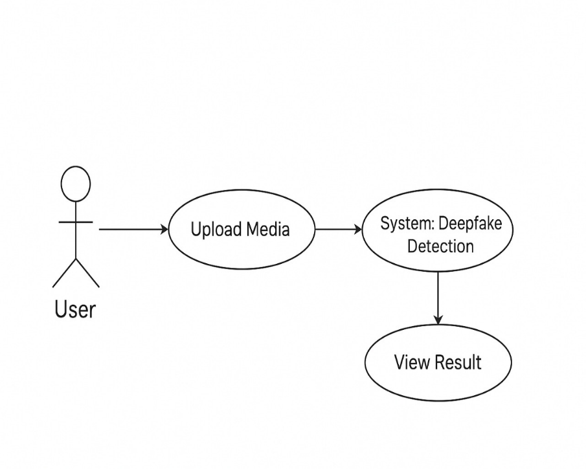
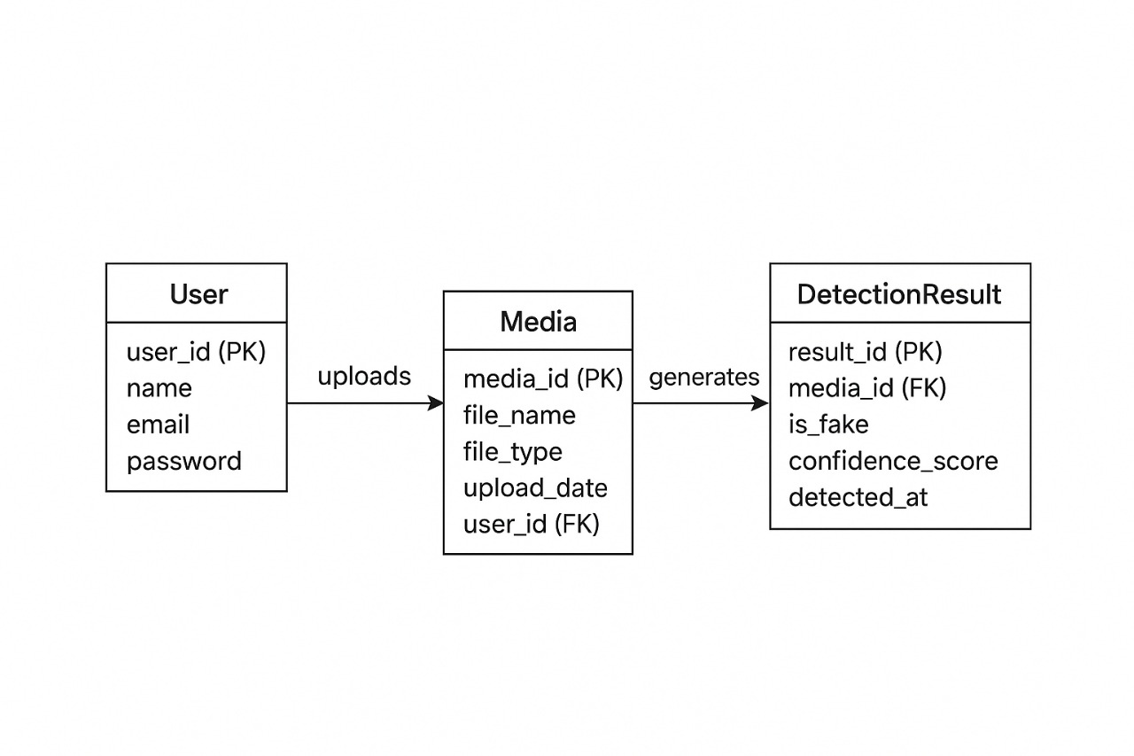
Design
Fig. E-R Diagram
Fig. Use Case Diagram
The diagram represents how the Fake News Detection Tool works. A User interacts with the system by uploading media (image, text, or video). The System processes the uploaded file using pre-trained machine learning models to check whether it is real or fake. After processing, the system provides feedback, and the User can view the result in a simple and understandable format.
This flow ensures an easy user experience:
Input – User uploads a file.
Processing – System performs deepfake detection.
Output – Result is displayed (Real/Fake).
Explanation of ER Diagram
User Table
Stores user information (ID, name, email, password).
Each user can upload media files.
Media Table
Stores details of uploaded media (ID, file name, type, upload date, user)
Each media is linked to the user who uploaded it
DetectionResult Table
Stores deepfake detection results. Each detection result is linked to a media file.

Slide 5
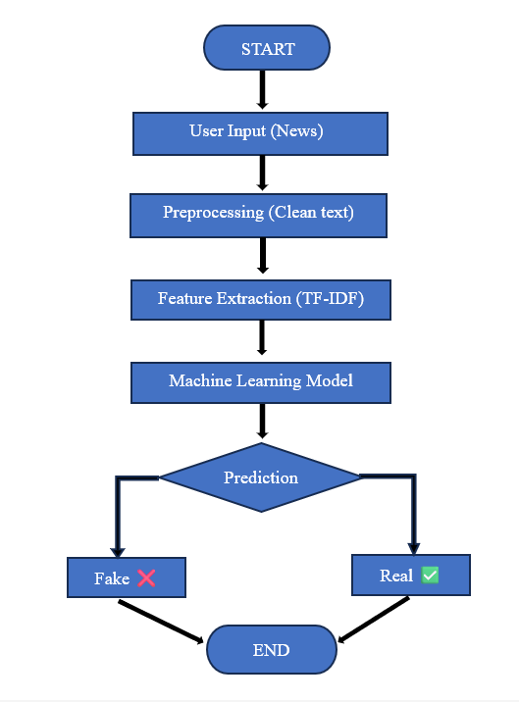
Design
Fake News Detection Process
Start
The system begins.
User Input (News)
User enters the news text to check if it’s real or fake.
Preprocessing (Clean Text)
The system cleans the text (removes special characters, extra spaces, etc.).
Feature Extraction (TF-IDF)
Important words are picked using a method called TF-IDF.
Machine Learning Model
A trained model is used to understand and analyze the news.
Prediction
The model checks whether the news is fake or real.
Output
✅ If real → Show “Real News”
❌ If fake → Show “Fake News”
End
The process is complete.
Fig. Flow Diagram

Slide 6
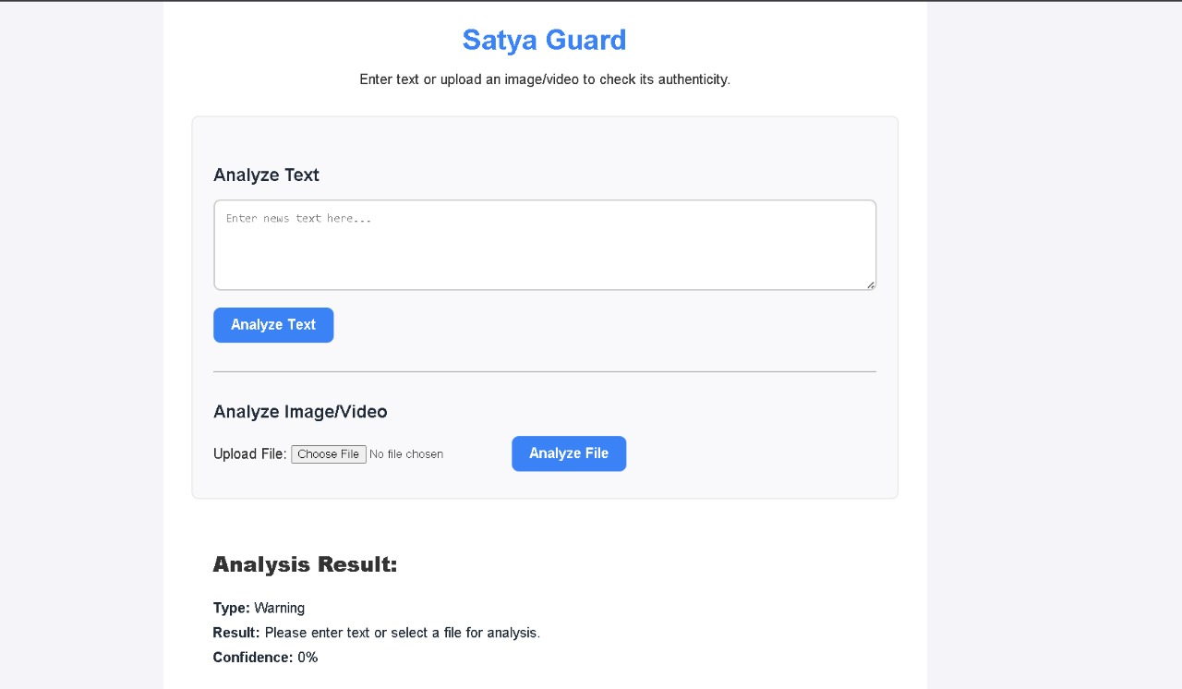
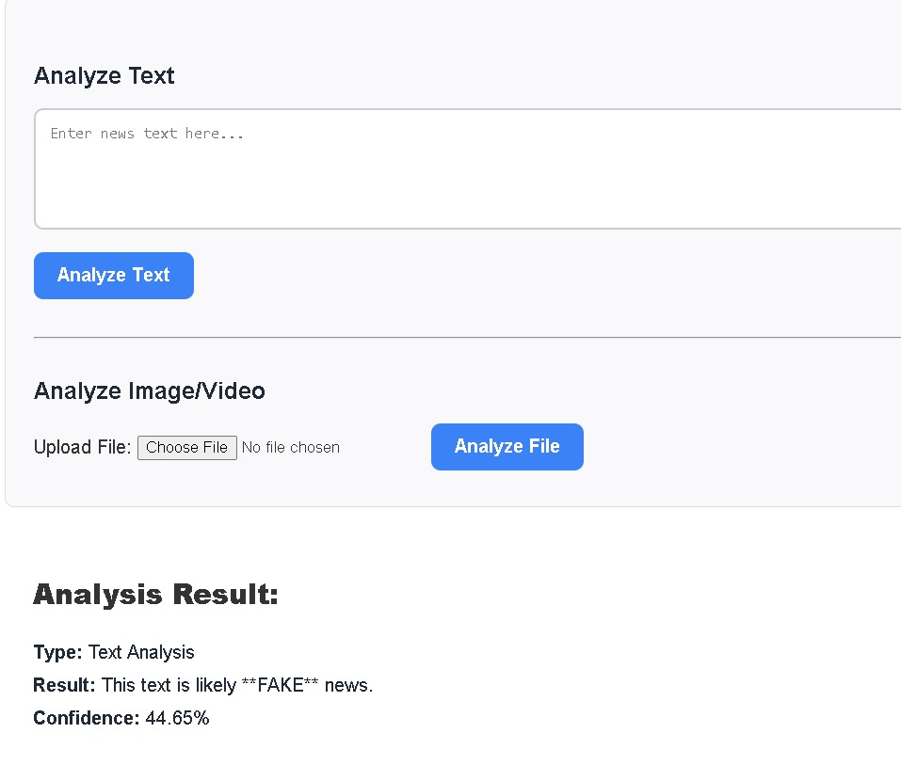
Screenshots

Slide 7
Literature Survey
Paper Name | Introduction | Limitation | Refrences
Liar, Liar Pants on Fire": A New Benchmark Dataset for Fake News Detection | This paper introduces the LIAR dataset, which is a highly influential resource for fake news research. Unlike simple real/fake datasets, LIAR classifies claims from the PolitiFact website into six categories (e.g., true, mostly true, half-true, false). | While groundbreaking, the dataset is limited to political claims from a single source (PolitiFact). This can introduce bias and may not represent the diverse nature of fake news on other topics or platforms like social media. | Wang, W. Y. (2017). "Liar, Liar Pants on Fire": A New Benchmark Dataset for Fake News Detection.
A Survey on Fake News Detection on Social Media | This paper provides a broad overview of fake news detection, discussing not just the text itself, but also social context. The authors propose a framework that considers features like user behavior, how news spreads, and the reputation of the source, in addition to the text. | The paper is a survey of existing work, so it doesn't offer a new, specific implementation. While it highlights the importance of social context, many of these features are difficult to collect and analyze in real-time. | Shu, K., Sliva, A., Wang, S., Tang, J., & Liu, H. (2017). Fake News Detection on Social Media: A Data Mining Perspective.

Slide 8


